Slide 1

Capstone Project Northwind Traders

Slide 2
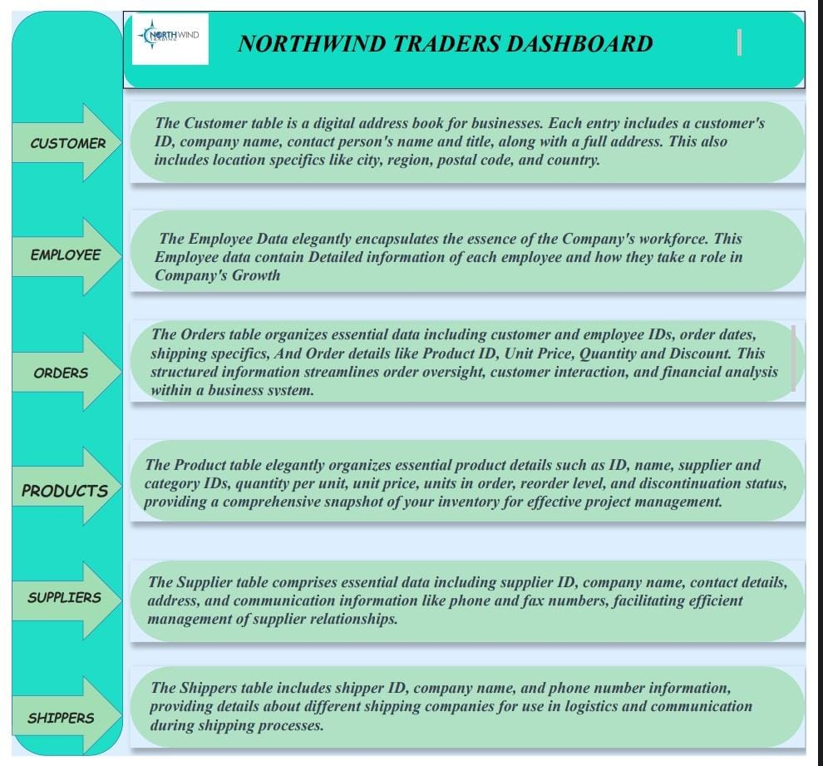

Slide 3
Project Objective
Conduct a comprehensive analysis of Northwind Traders Sales Analytics dataset:
- Identify Patterns, Trends, and Influential Factors
- Enhance Sales Growth and Making
More profittable

Slide 4
Approach:
- Source and Clean Northwind Traders Data
- Explore Patterns Through Visualization
- Analyse Factors Impacting Sales
- Address Limitations and Biases

Slide 5
Key Findings and Insights:
- Correlation Between Factors and Sales
- Strategies to Mitigate Biases
Enhancing Decision-Making in Sales

Slide 6
Key Findings and Insights:
- Correlation Between Factors and Sales
- Strategies to Mitigate Biases
Enhancing Decision-Making in Sales

Slide 7
The Northwind database contains sales data for a fictitious company called Northwind Traders, which imports and exports specialty foods from around the world. The Northwind Traders project seeks to transform the company by embracing technology and optimizing operations to create a more efficient, customer-focused, and profitable business.
The objective of the Northwind Traders project is to implement a comprehensive business solution that optimizes various aspects of the company's operations, enhances customer satisfaction, and improves overall profitability. The project aims to achieve this by streamlining internal processes, leveraging technology, and delivering a seamless experience for both customers and employees.
The project will involve the following tasks:
Analysing the Customer acquisition over time, Segmenting the Customer Based on their region and country.

Slide 8
Examine Employees Performance, Productivity and Employee tenure
Analysing the orders, order frequency of customer, and finding orders discontinued by the customer
Performing deep analyse on suppliers and shippers, and inspecting what are the orders were not shipped yet
Inspecting product quantity, unit price, orders in stock, units on order and finding the reorder level and grouping the products to their categories.
Deriving meaningful conclusions and recommendations for improving ranking methodologies
Compiling analysis results, conclusions, and recommendations for stakeholders.

Slide 9
This project is significant because it has the potential to improve the Customer loyalty, profit growth to company and increase the sales. By understanding the factors that influence Customer and Employee Satisfaction can better position themselves to succeed in the global marketplace.

Slide 10
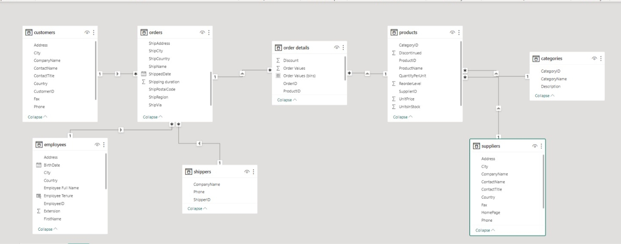
ER DIAGRAM

Slide 11
POWER BI PROBLEM STATEMENT

Slide 12
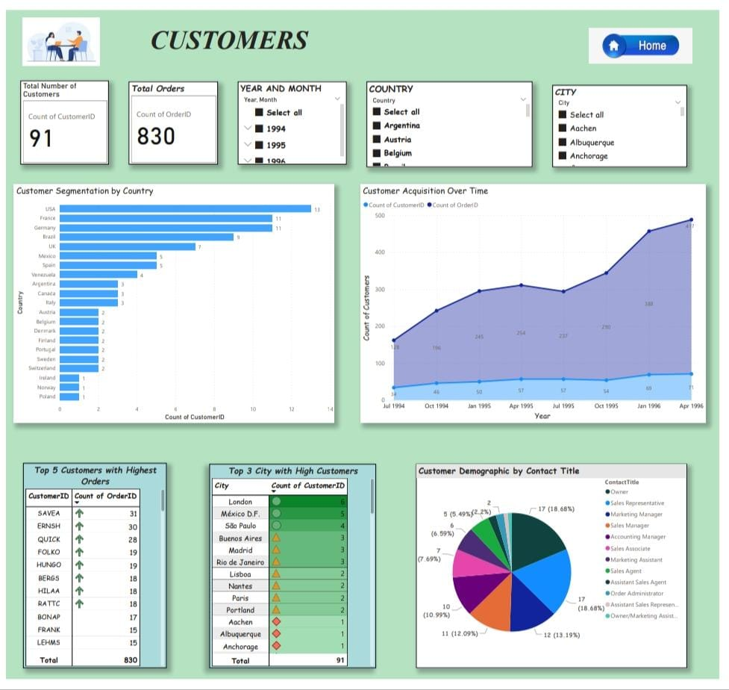

Slide 13
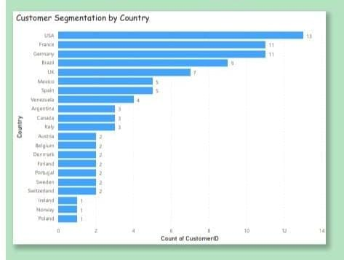
How does customer distribution vary across different regions or customer segments?
Customer segmentation is the tagging and grouping of customers with shared characteristics like age, Industry, gender, Location and interests. Companies employing customer segmentation know that each customer is different and that targeting all their customers with one approach isn't effective. Instead, the organization's marketing efforts would be better served if they target specific, smaller groups with messages those consumers find relevant. By Examining the Customer table, we can make Customer Segmentation by Country. With this we also calculate the Top 3 Countries which has high number of customers. The top 3 countries who have most customers are USA-13 customer, France and Germany – 11 customers and Brazil as 9 customers. With Customer Segmentation we can easily personalise the marketing, service and sales efforts needs to specific Group.

Slide 14
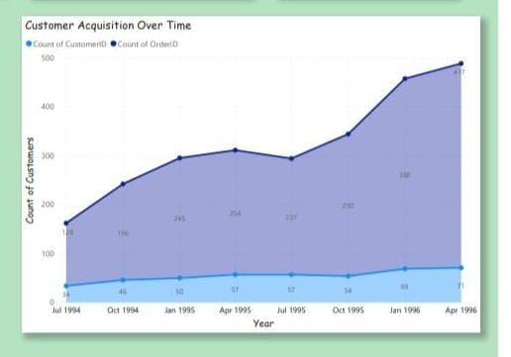
What is the trend in customer acquisition over time?
Analysing how many orders were placed by customer for each year mean we can find our growth market. By inspecting customer finally, we conclude The Customers count and orders counts are increased from year 1994 to year 1996.
Customer acquisition is a fundamental aspect of business growth and success. By implementing effective acquisition strategies, businesses can expand their customer base, increase revenue, and establish a competitive advantage.

Slide 15
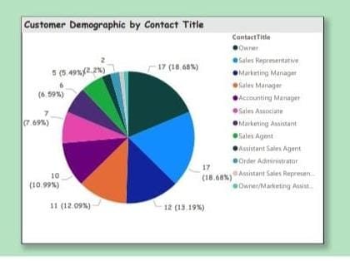
Can we visualize the distribution of customer demographics such as age, gender, or income?
Analysing the customer table there is no data related to age, gender o income. We can take Customer’s Contact title as demographic. By analysing customer’s demographic, we can find that most of the customers belongs to Owner, Sales representative and Marketing manager.
The Customer Demographic data is used by businesses to help them understand the characteristics of the people who buy their products and services.

Slide 16
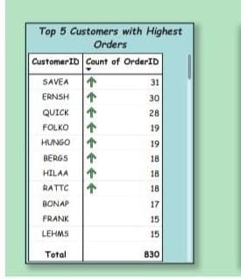
Top Five Customers
Calculating the Count of Orders for each customer id give the Top 5 Customers who Orders the most. This indicates Customers loyalty towards the Company.

Slide 17
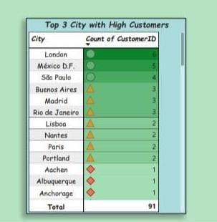
Top 3 City
For this we can take the Customers count for each City with this we can find Top 3 City with high customers. London, Mexico and São Paulo are the top 3 cities .

Slide 18
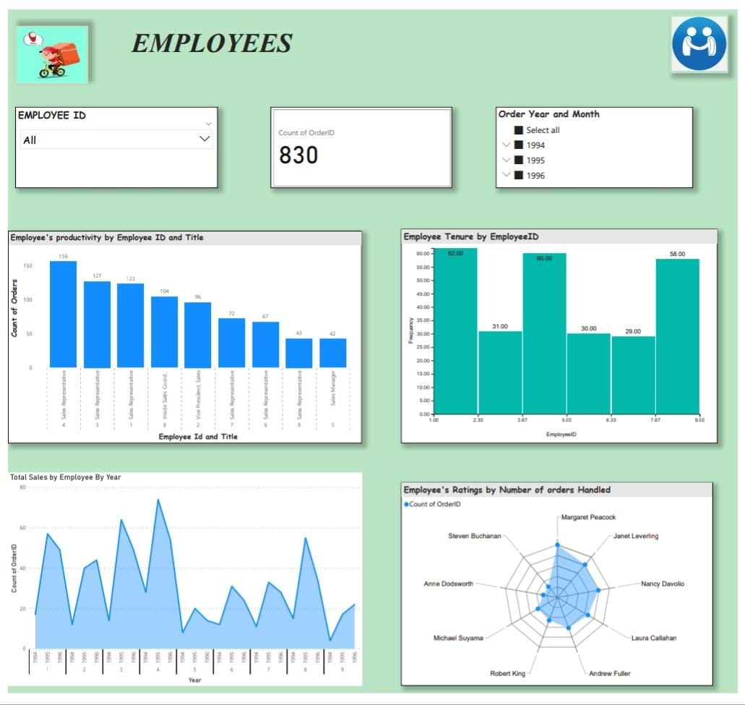

Slide 19
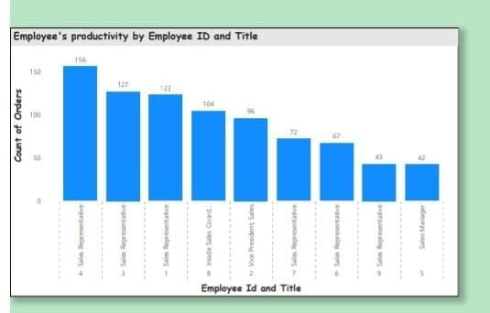
How does employee productivity vary across different departments or job roles?
The Employee Productivity can be defined as the amount of work or output produced by am Employee in a Specific Period of time. Workplace productivity is the value each team brings to the success of the overall business.
By analysing we can conclude that Employee’s productivity is vary across the different departments or job roles. Because Sales Representative job role Employee’s handles the max orders comparing with Sales manager, Inside Sales Coordinator and Vice President, Sales. The total orders handle by the Sales representatives were 701.

Slide 20
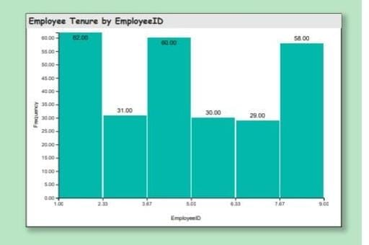
What is the distribution of employee tenure?
Employee tenure means the period of a time a person works at a particular job title o office. Employees who have been with a firm for over five years are long-tenured, while those who have been with the company for less than five years are short-tenured.
We can calculate employee tenure with hire date and there is no relevant data when the employee switch to another organisation. Is there any data available related to dismissal then the employee still working there only. We can use Histogram chart to visualizing the distribution of Employee tenure.
For calculating Employee tenure:
Employee tenure = datediff([hiredate], today (), year)

Slide 21
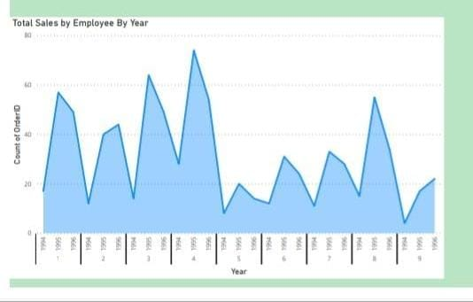
How many sales were done by each employee by Each year?
Analyse the Each employee with orders handled by them for each year mean we can find Sales of Employees. By analysing the employee table, the orders handled by the Employee increase and decrease. The Employee Id 4 handles the maximum number of orders compared to other employees.

Slide 22
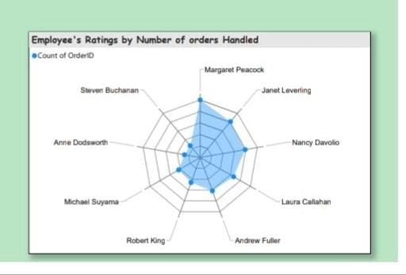
Can we visualize employee performance ratings?
Examining the count of orders handled by the employee, we can give performance ratings. We Can give five-star ratings for the employee Margaret Peacock because he/she handled he maximum number of orders during three years. In 1994, 1995 and 1996 all the three Years the employee ID 4 that is Margaret Peacock Handled the maximum number of orders. The remaining Employees Performance may vary year to year

Slide 23
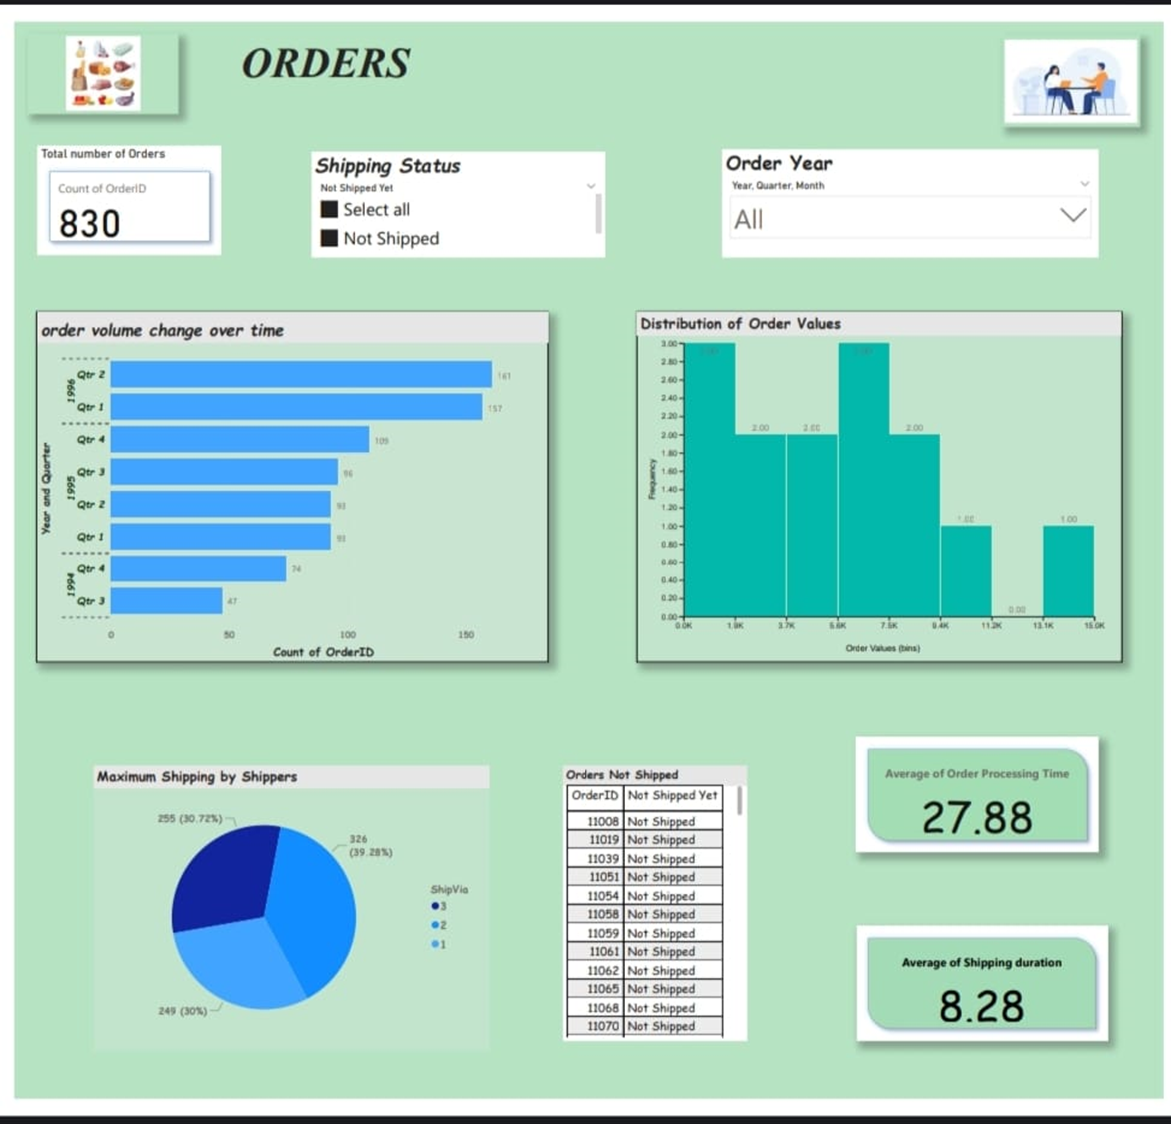

Slide 24
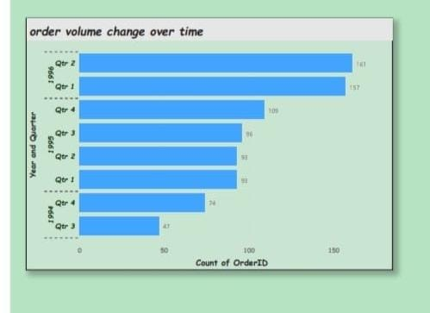
How does order volume change over time?
To analyse the order volume change over time, we have to take count of orders for each year. It Indicates the retention of customer and customers Loyalty towards the company. Comparing with the year 1994, in 1995 are orders were increased and 1996 orders also increased. It indicates the company’s growth.

Slide 25
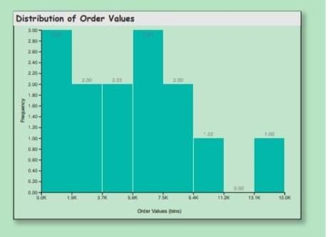
What is the distribution of order values?
To determine the distribution of order values from the table, we need o calculate the total value of each order first.
Order value= (unit price * Quantity)-Discount.
We can Visualize it with the help of histogram for better understanding.

Slide 26
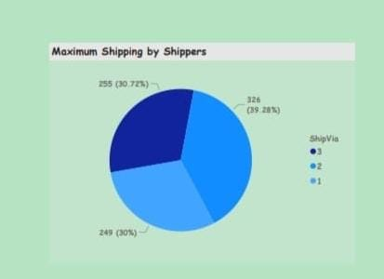
How to calculate how many orders are shipped by each shipper?
It is important to analyse what are the products and counts of the products are shipped by shipping company. With the help of shipped date, we can find the order delay and does It cause Customers discontinuation. Customers satisfaction is very important for business growth. Late shipping may cause customers dissatisfaction. The shipper ID 3 ships the maximum number of orders that is 326 orders.

Slide 27
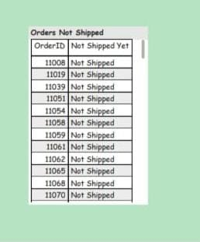
How to fid what are the orders are not shipped yet?
The order table contain shipping date for each order. To find the count of orders not shipped yet, we can take null values of the Shipped date. Because the order not yet shipped means they leave the record empty. And also, we have to analyse the reason for not shipping. Which shipping company ships that order and find the order shipping was delay or that order have time to ship.20 orders are not shipped yet.

Slide 28
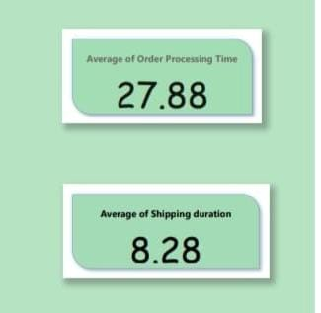
Can we visualize the average order processing time or shipping duration
Order Processing Time = Required date – Order date
Average Shipping Duration = Shipped date – Order Date
With this calculation we can find Average order processing time and average shipping duration.

Slide 29
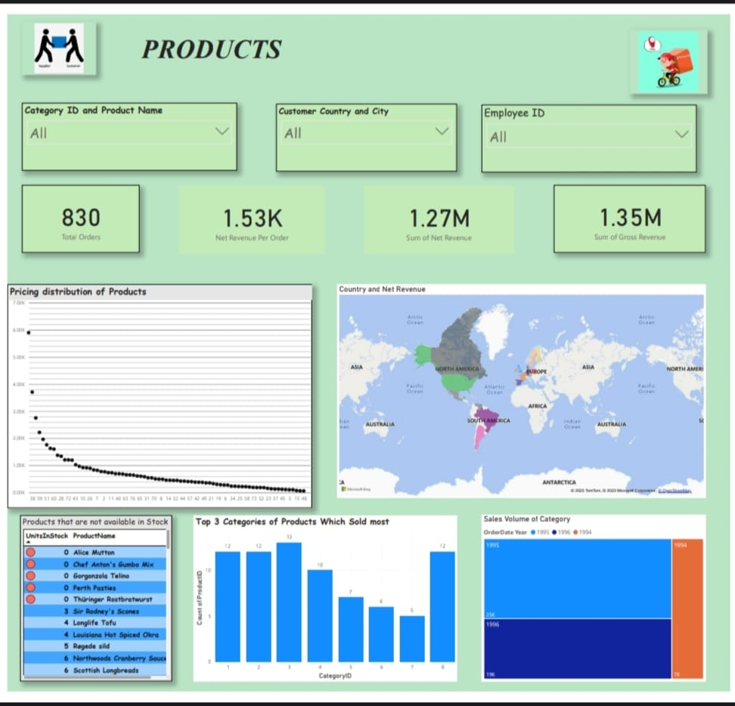

Slide 30
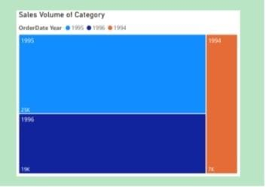
How does the sales volume vary across different product categories?
Analysing each product Category. Every year the sales volume of the product categories was increase. Sales volume refers to the number of units your company sells during a specific reporting period. This period could be a month, a quarter, or a year depending on what level of sales volume you're seeking to analyse. Investors frequently look at sales volume to assess the health of a growing or contracting company.

Slide 31
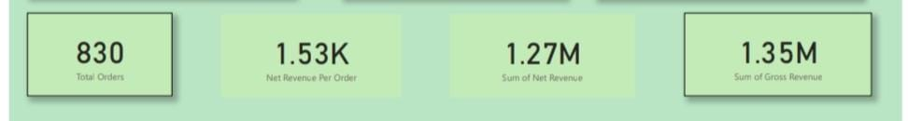
Revenue generated by the products
Total Orders = 830
Net Revenue Per Order = DIVIDE (sum ('order details'[Net Revenue]), [Total Orders])
Net Revenue:
Net revenue, or net income, is equal to a company's gross revenue minus all of its expenses, including fixed expenses.
Sum of Net Revenue = 'order details'[Gross Revenue] - 'order details'[Discount]
Gross Revenue:
Gross revenue, also known as gross income, is the sum of all money generated by a business, without taking into account any part of that total that has been or will be used for expenses.
Gross Revenue = ' 'order details'[Unit Price] * 'order details'[Quantity]
We can display this revenue with the help of cards.

Slide 32
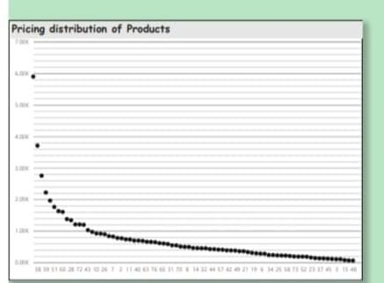
Can we visualize the pricing distribution of products
To visualise the pricing distribution of products we have t take product id and unit price. We can Visualise it by using plot box chart.
Pricing is an important decision-making aspect after the product is manufactured. Price determines the future of the product, acceptability of the product to the customers and return and profitability from the product. It is a tool of competition.

Slide 33
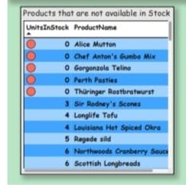
Analyse what are the products are not available in the stock
It is necessary to know the availability of the products in the stock. The unavailability of the products may lead to delayed delivery and customer dissatisfaction. We can analyse the Products not available in the stock with the help of tables.
Some ways to measure product availability:
Weekly gap scan score – what the associates can see as out-of-stock on the shelf.
Online first-time pick rate – personal shopper pick performance.
Image capture – video and photo of what's available either continuously or at set times of the day.

Slide 34
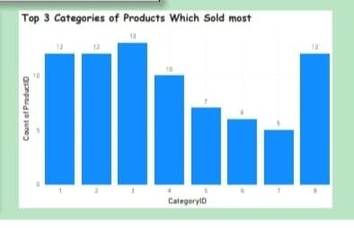
Top 3 Product Category Sold most:
Analysing the Most Product categories sold indicates Customer’s Interest or need of that product. With the help of this we can increase sales by targeting customers.
Confections, beverages, Condiments, sea food and Dairy products are the top 3 high sold product categories.

Slide 35
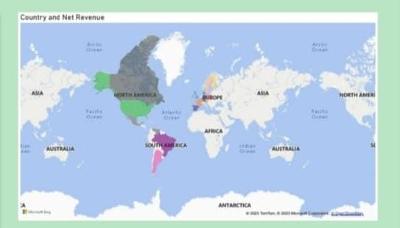
Country and Net Revenue:
The map chart indicates the country wise net revenue generated by the products.

Slide 36
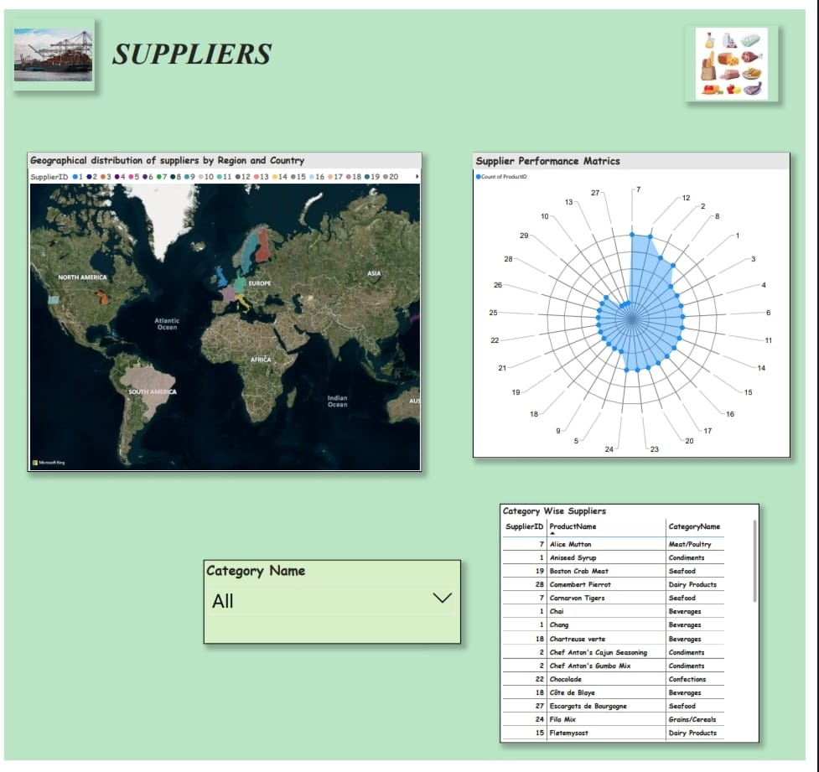

Slide 37
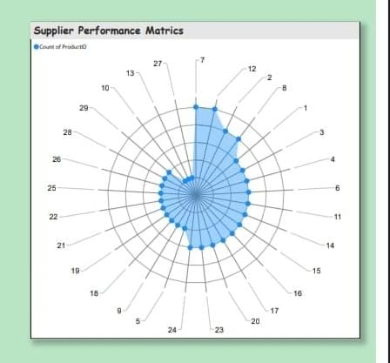
What is the distribution of supplier ratings or performance metrics?
Analyse the supplier Performance Matrix with the help of count of supplies made by the Suppliers. To visualise this, we can use Radar Chart.
The supplier ID 7,12,2 and 8 are the best supplier according to count of supplies.

Slide 38
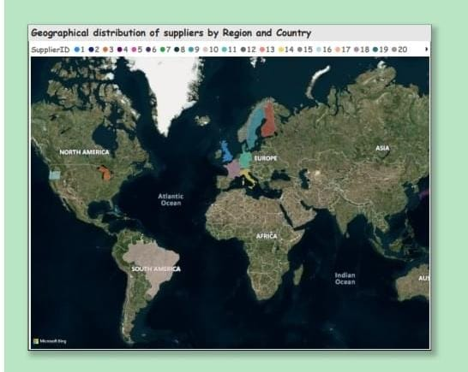
Can we visualize the geographical distribution of suppliers
The map chart distributes the supplier by country and region.

Slide 39
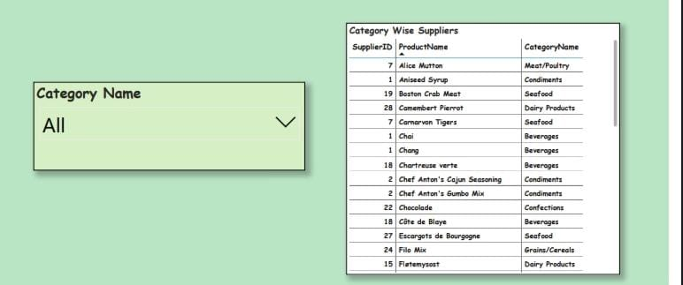
Distribute the Products to their Categories

Slide 40
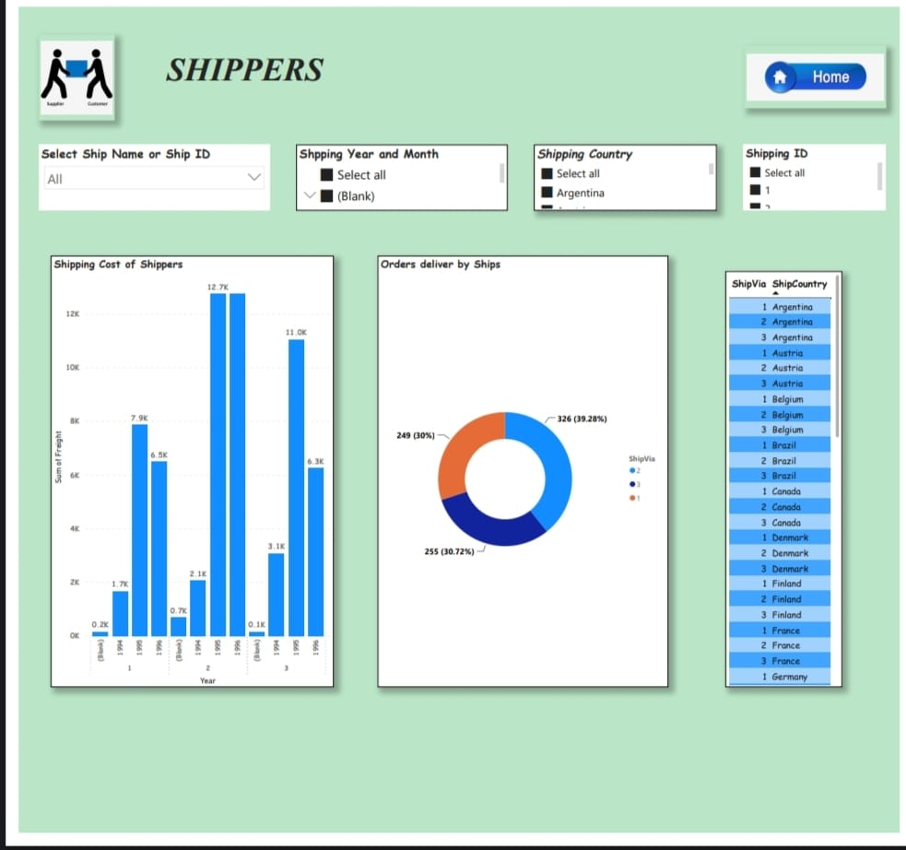

Slide 41
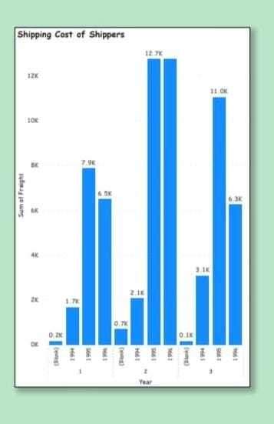
Shipping Cost of the shippers:
One of the key reasons is that shipping cost has a direct impact on profits of any business. If an exporter does not know how much they have to pay to ship goods to an importer, they may face challenges while determining profit margins
We can calculate the sum of Freight of each Shippers. The Shipping Company 2 ships the maximum order.

Slide 42
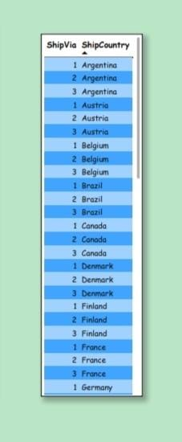
How does Shipper’s distribution vary across different regions or customer segments?
There are totally 3 shipping Companies are there.These three companies only shipped the all orders of the Customers.

Slide 43
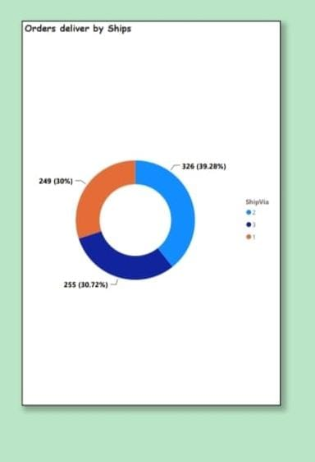
Count Of Orders Deliver By the Shippers

Slide 44
EDA PROBLEM STATEMENT

Slide 45
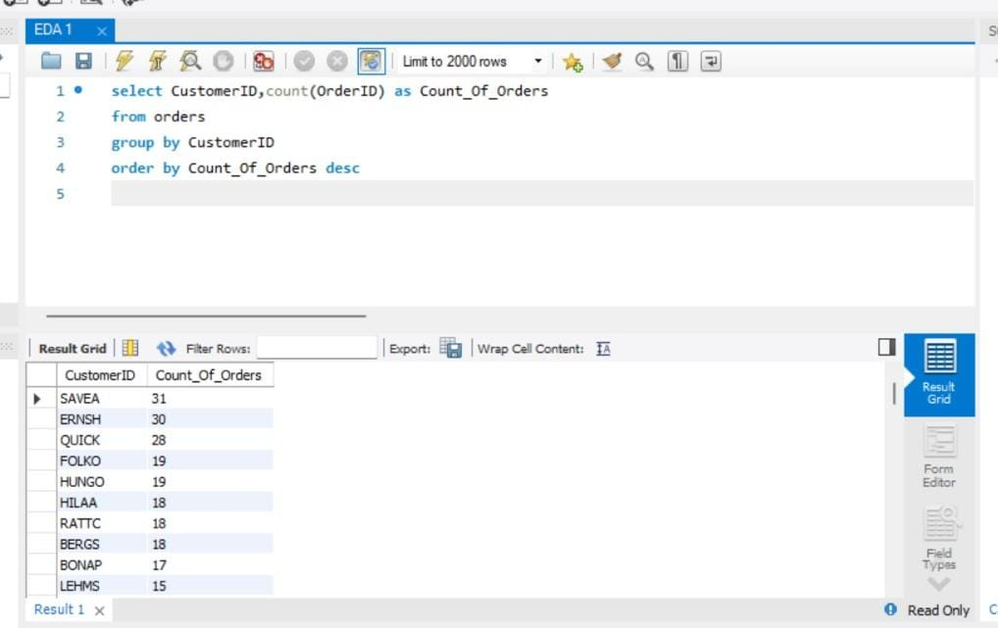
What are the key factors influencing customer retention or loyalty based on the dataset?
Customer retention is a metric that measures customers loyalty. Customer loyalty means establishing longer and more sustainable products.
In Simply we said Customer loyalty means who made the repeated purchase.
Customer satisfaction is one of the key factor of the customers retention.
With the help of orders table we can see most of the customers did repeated orders.

Slide 46
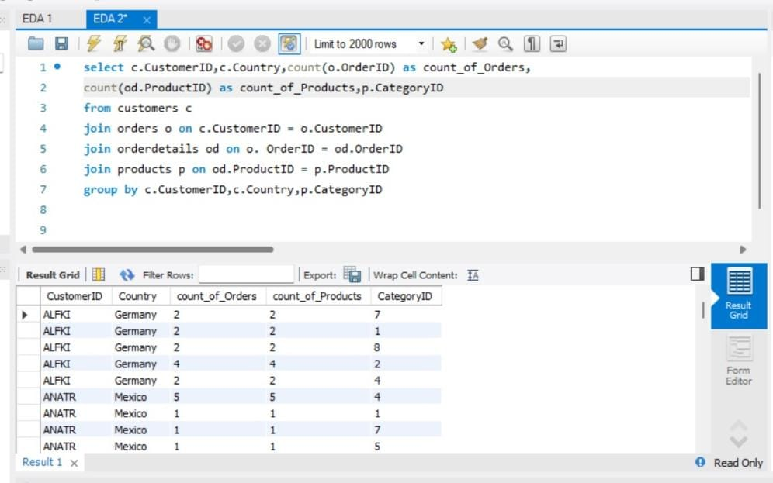
How do customer preferences vary based on their location or demographics?
If the retail location is easy to find then the customer will tend to be loyal.
Location based marketing allows organizations to target customers at a granular.
For this we can take CustomerId, country, Count of orders, and Category id.
For this we have to join customers tablw tith orders table, order detail table and products table

Slide 47
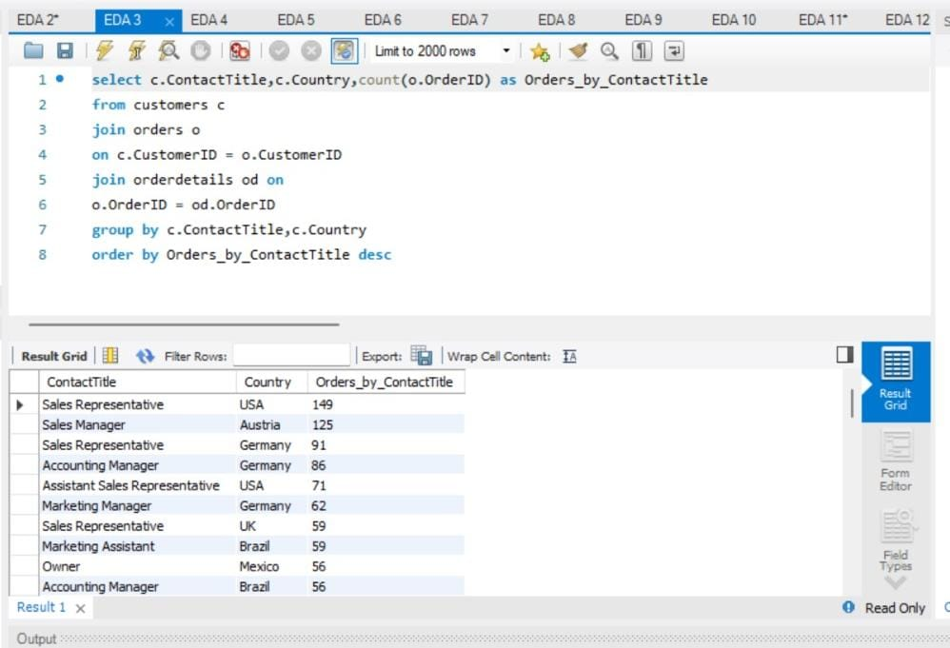
Are there any interesting patterns or clusters in customer behavior that can be visualized to identify potential market segments?
To find interesting pattern I took contact title and count of orders made by them.

Slide 48
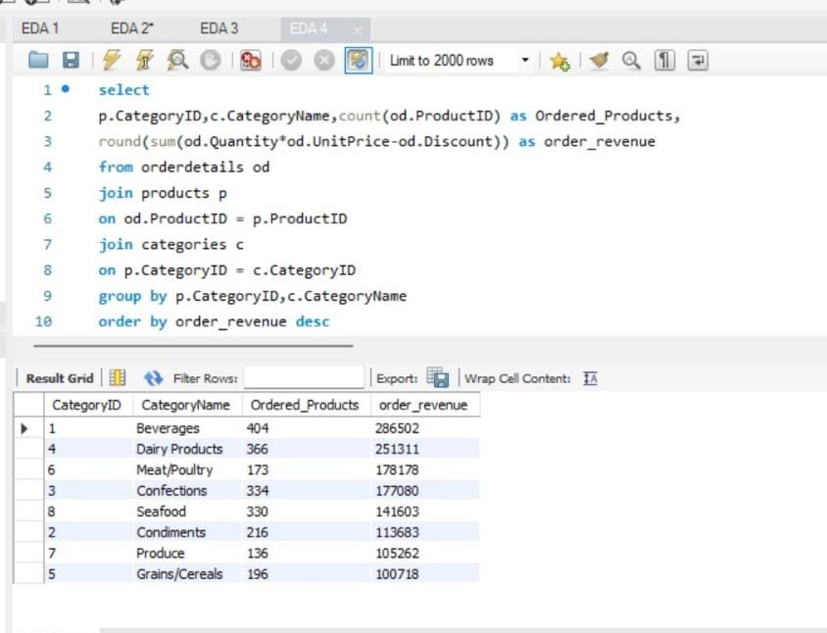
Are there any specific product categories or SKUs that contribute significantly to order revenue?
Category Id significantly helps us to increase order revenue.
Analysing the product category and its revenue
We can find that CategoryId 1 that belongs to Beverages Ordererd Products is high and Order revenue is also high.

Slide 49
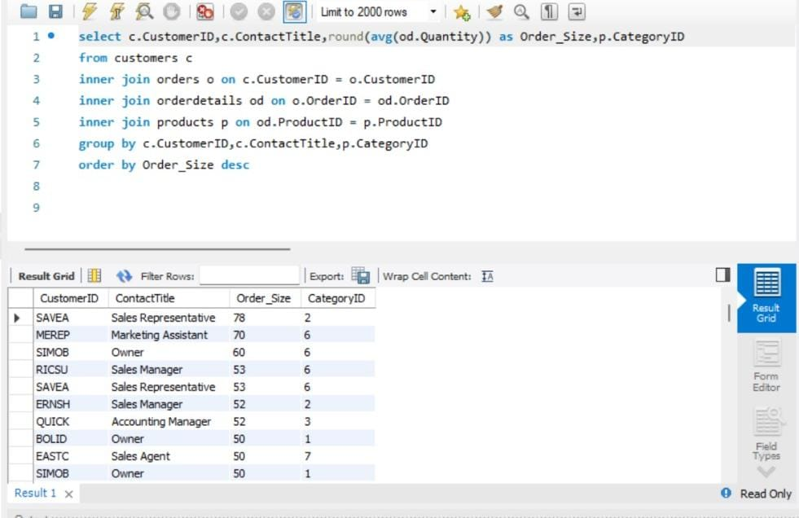
Are there any correlations between order size and customer demographics or product categories?

Slide 50
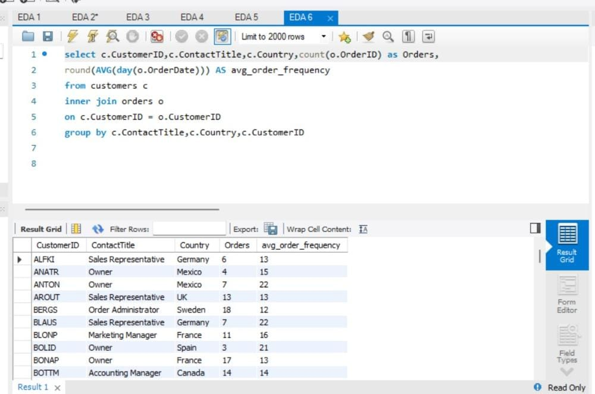
How does order frequency vary across different customer segments

Slide 51
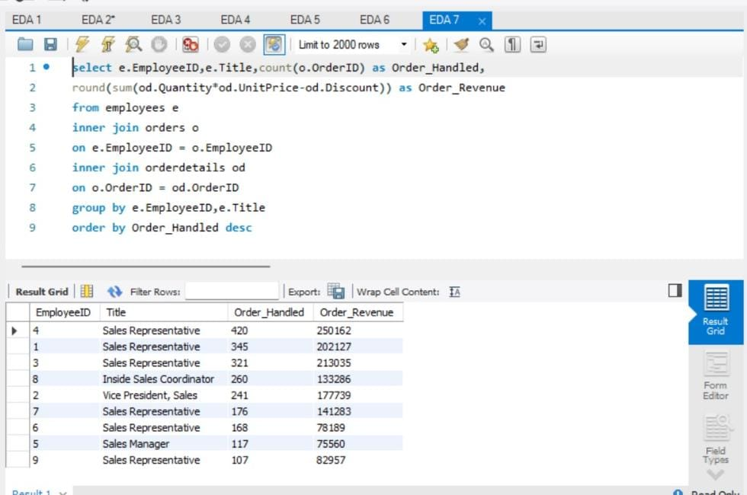
How does employee turnover vary across different departments or job roles?

Slide 52
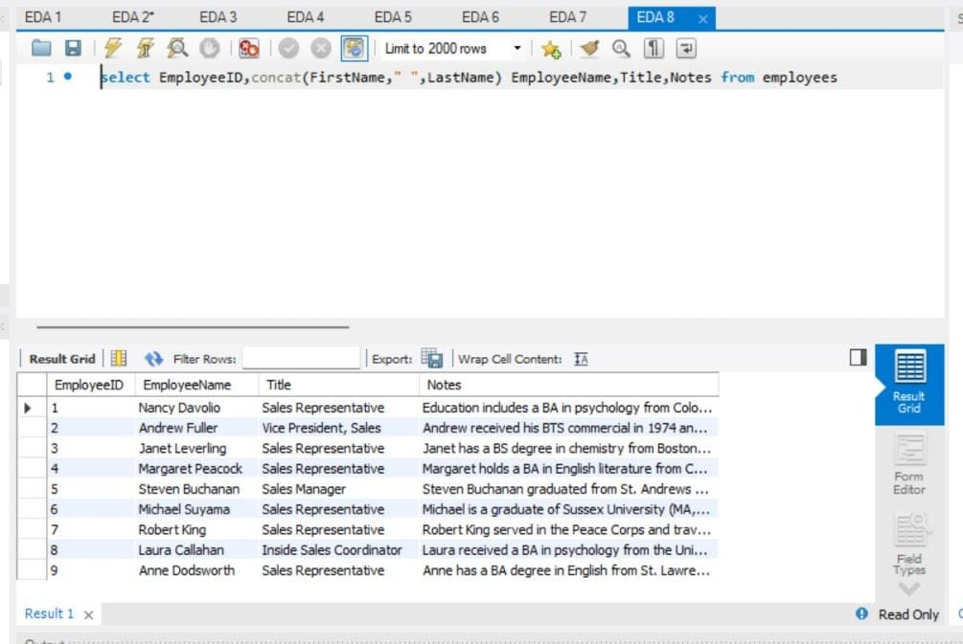
Can we identify any patterns or clusters in employee skill sets or qualifications

Slide 53
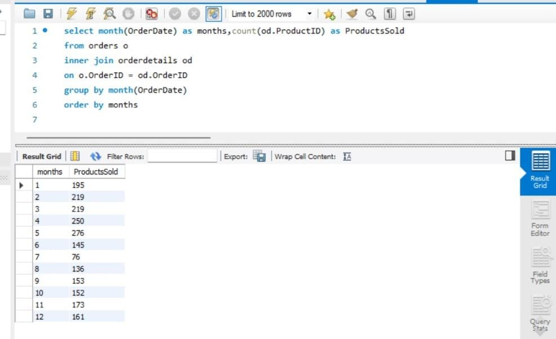
How does product demand fluctuate over different seasons or months

Slide 54
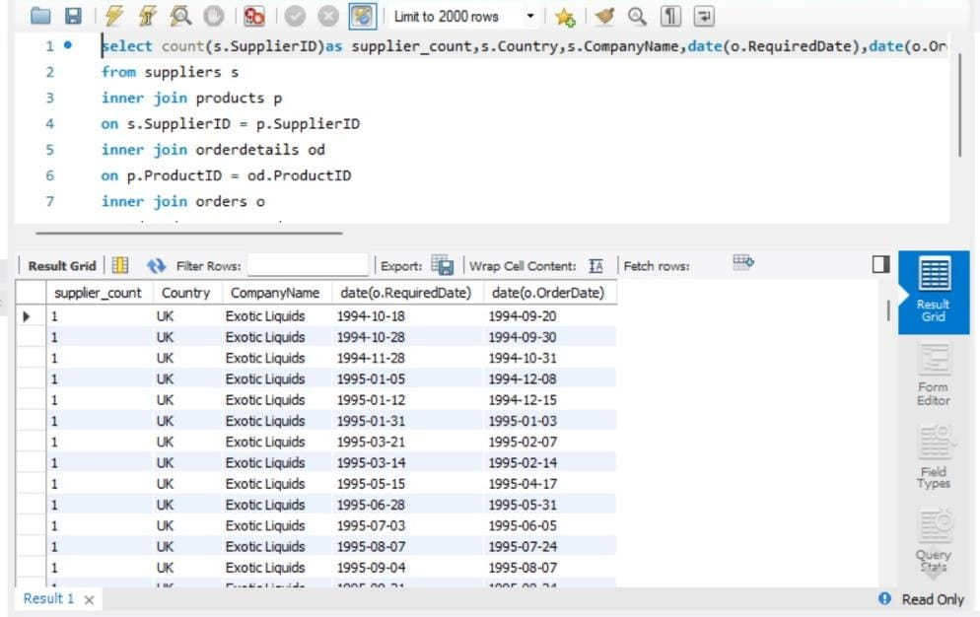
Are there any correlations between supplier attributes (e.g., location, size, industry) and performance metrics

Slide 55
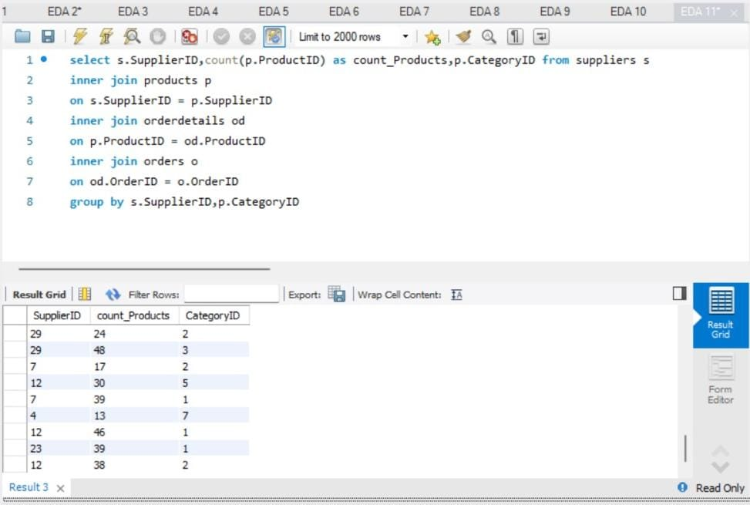
How does supplier performance vary across different product categories or departments?

Slide 56
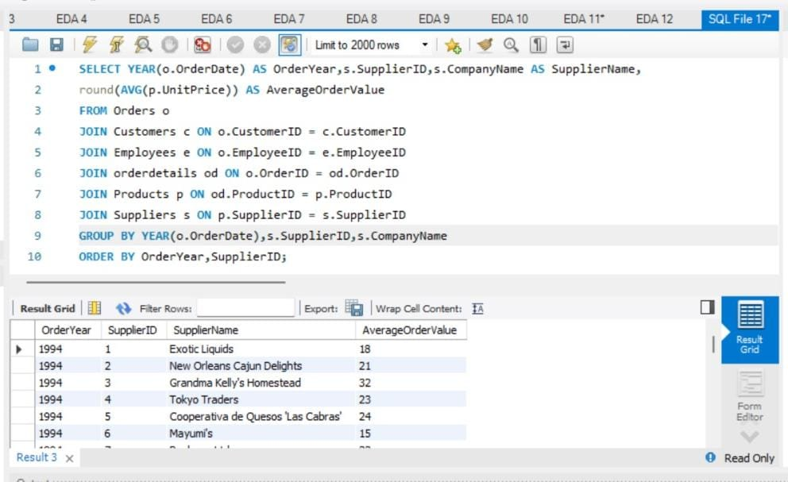
Can we identify any trends or patterns in supplier costs or pricing structures through visualizations

